Slide 1

ECG Signal Conditioning Circuit
Amplifying and Filtering Weak Heart Signals for Clean Monitoring
TEAM MEMBERS:-
Alishba Muhammad Ali
Aisha Shakeel
Dua Kashif
Laraib Rizwan
Saad Noor

Slide 2
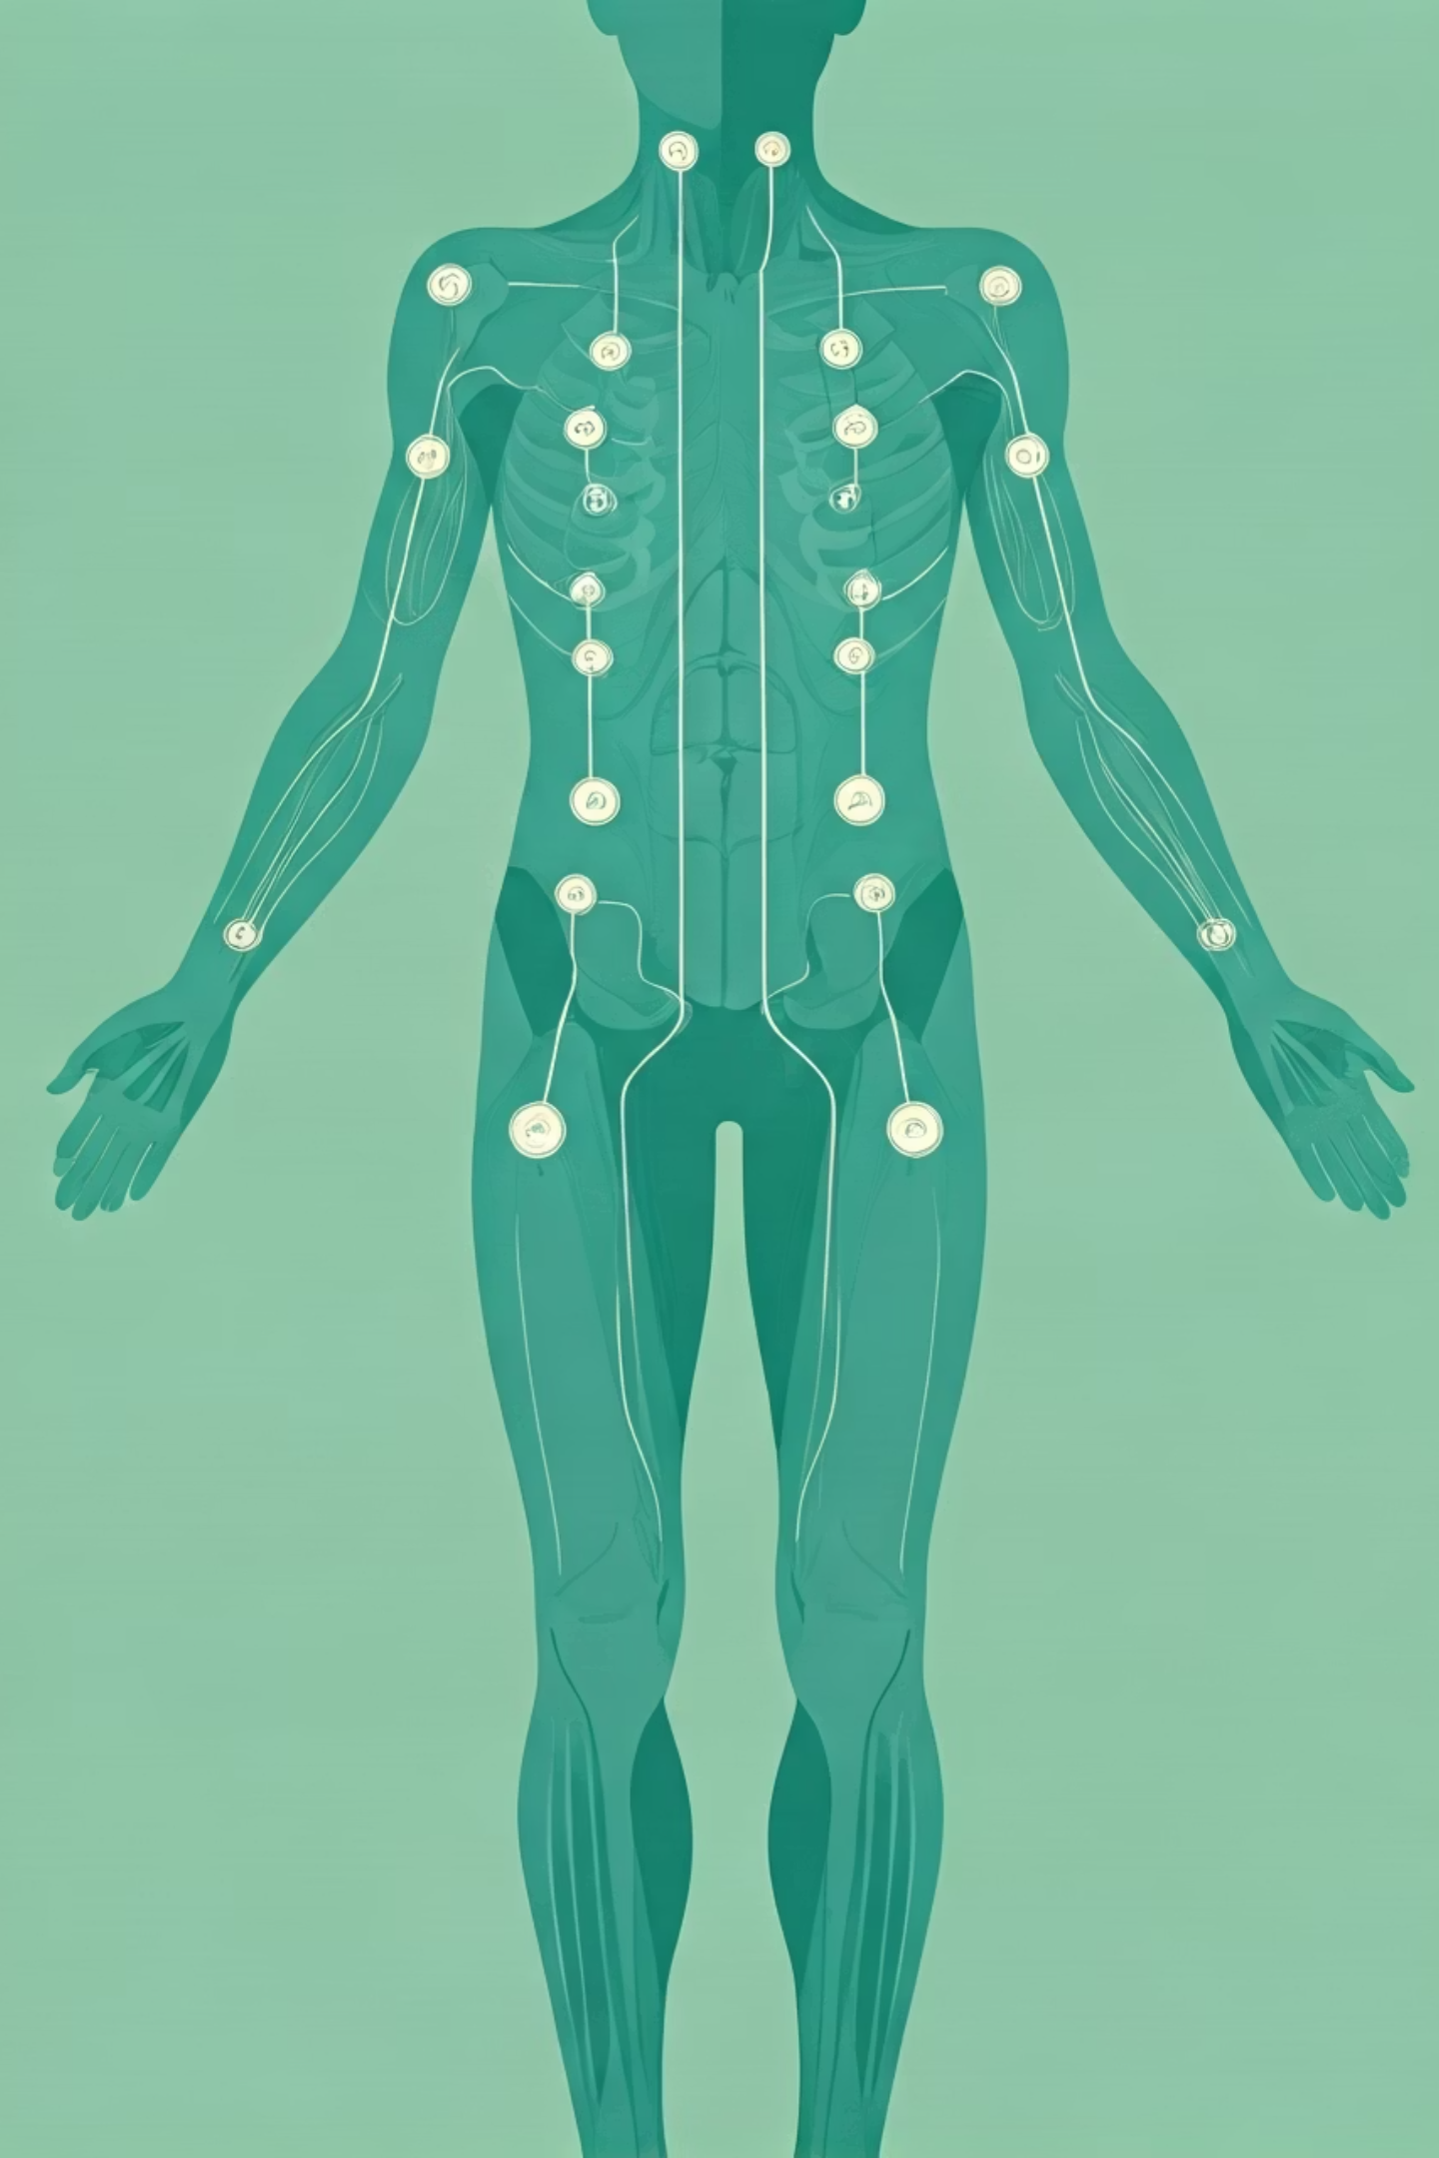
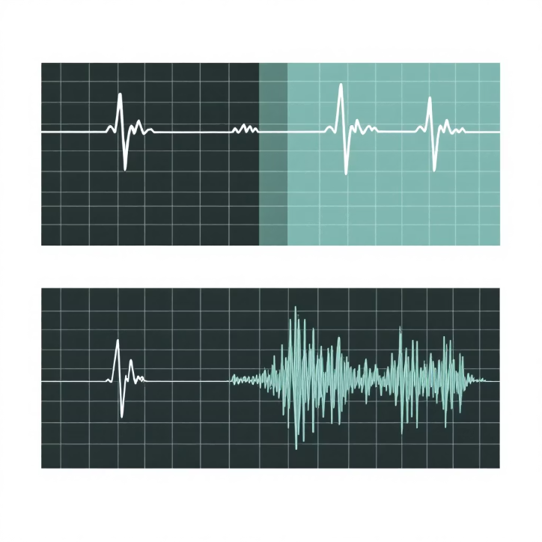
What is ECG and Why Signal Conditioning?
Electrocardiography (ECG) measures the heart's electrical activity.
Signals are extremely weak (microvolts to millivolts)
Prone to noise:
Power-line interference (50Hz)
Muscle noise (EMG)
Baseline drift (movement, breathing)
The Big Picture: Our circuit amplifies tiny signals, removes disruptive noise, and outputs a clean, interpretable waveform for reliable monitoring.

Slide 3

Step-by-Step Signal Processing
Signal Detection
Heart produces tiny electrical signals, picked up by surface electrodes.
Initial Amplification & Buffering
Buffers gently amplify without distorting the fragile signal; protects the patient.
Noise Rejection
Differential amplifier boosts the difference between electrodes, powerfully rejecting common-mode noise.
Baseline Stabilisation
High-pass filter removes slow DC offsets and baseline wander caused by breathing or motion.
Final Shaping & Filtering
Final stage adds gain, shifts DC offset (e.g., 2.5V for positive signals), and filters out high-frequency muscle noise.

Slide 4
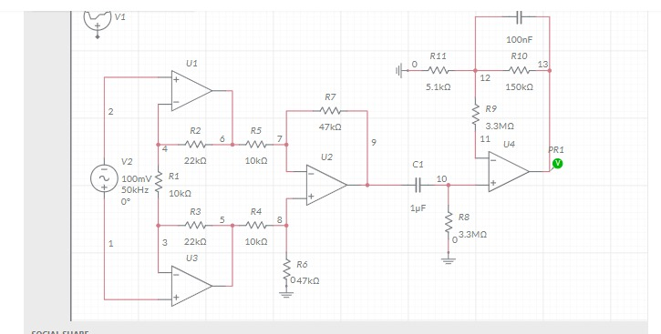
components of circuits:
🔹 Stage 1: Input Amplification (U1 & U3)
Op-amps used as pre-amplifiers
Resistors R1–R4 provide feedback and set gain
Improves signal strength
Stabilizes input for next stage
🔹 Stage 2: Differential / Gain Stage (U2)
Combines outputs of U1 and U3
Resistors R5, R6, R7 control gain
Amplifies signal further
Reduces noise and improves accuracy
🔹 Stage 3: AC Coupling & Filtering
C1 (1 µF) blocks DC components
Allows only AC signal
Acts as a high-pass filter
🔹 Stage 4: Output Amplifier & Filtering (U4)
Final amplification stage
R9, R10, R11 set gain and bias
100 nF capacitor removes high-frequency noise
Produces clean and stable output

Slide 5
working of the circuit:
A weak AC signal is applied at the input of the circuit.
U1 and U3 increase the strength of this weak signal (first amplification).
The outputs of U1 and U3 go to U2, which further amplifies the signal and removes noise.
C1 capacitor blocks unwanted DC voltage and allows only the AC signal to pass.
U4 amplifies the signal one last time and removes high-frequency noise.
At the output, we get a clean and strong AC signal.

Slide 6
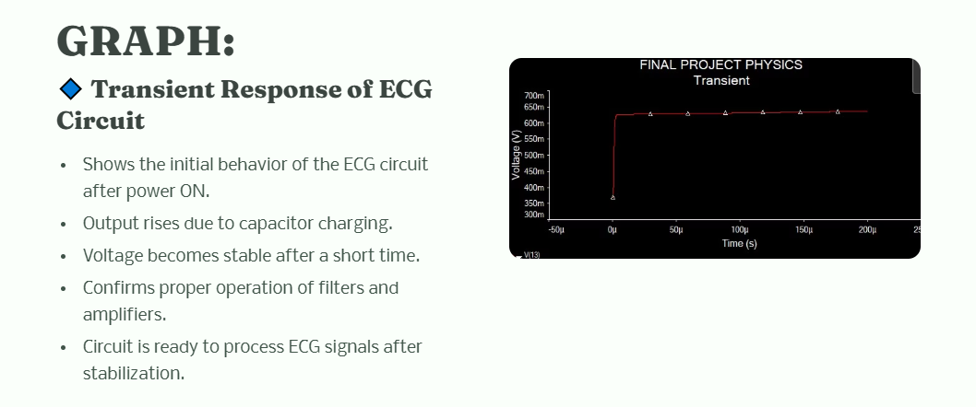

Slide 7




Uses and Importance
Heart Rate Monitoring & Diagnosis
Versatile Monitoring Systems
Digital Integration
Educational Tool
Essential input for microcontrollers (e.g., Arduino) for digital processing and analysis.
Ideal for teaching core principles of biomedical signal acquisition and processing.
From portable devices and Holter monitors to advanced hospital systems.
Detecting arrhythmias, ischemia, and other cardiac conditions.

Slide 8

A Deeper Look: The Role of Op-Amps
Operational amplifiers (Op-Amps) are the workhorses of this circuit, crucial for precise signal handling.
High Gain Amplification
Filtering Capabilities
Boosts the minute ECG signals to a usable voltage range.
Forms the core of active filters (high-pass, low-pass) to refine the signal quality.
Common-Mode Rejection
Buffering & Isolation
Instrumentation amplifiers (built with op-amps) excel at eliminating noise common to both inputs.
Prevents loading effects and provides high input impedance for accurate sensing.

Slide 9

Conclusion
This circuit effectively amplifies weak ECG signals, removes noise, and produces a clean output for reliable heart monitoring.
Low Noise: Minimised unwanted electrical interference.
High Common-Mode Rejection: Excellent at filtering out shared interference.
Simple Design: Cost-effective and straightforward to implement.

Slide 10

Q&A
We welcome your questions and insights.
Your curiosity drives our innovation.

